Slide 1

Programming for Engineers
Lab class 1
Dr Yue Wang
School of Artifical Intelligence
Autumn term 2021

Slide 2

Welcome to join our DingDing group:
 DingDing QR code:

Slide 3

Module Overview
 Introduce programming concepts and techniques in an Engineering context
 Learn how to program in C and C++ languages
 Get practical programming experience
Hierarchy of control
Variables
Commands
Algorithms
Computer
architectures
Data types
Pointers
Libraries
Embedded systems programming
Problem- solving
Functions
Object Oriented
Programming

Slide 4
Module Overview
LEARNING HOW TO PROGRAM
SOFTWARE DEVELOPMENT
COMPUTING FUNDAMENTALS
Foundations of programming
Developing software for
problem-solving
Embedded Computer System
The C programming language
From C to C++ (Object-orientation)
Computer architectures
Introduction to Machine code
Writing programs that talk to hardware
Week 1
Week 4
(Segments not to scale!)

Slide 5

Module Assessment
 50% Coursework – Programming project I
 Demonstrate skills and knowledge in the application of basic programming concepts and
techniques to a simple Engineering problem
 Software code and short report (2000-2500 words),
 Due in Week 10 of the semester, Sunday 19 November 2023, by 23：59PM
 50% Coursework – Programming project II
 Demonstrate skills and knowledge in the application of more advanced programming concepts and techniques to solve a more sophisticated problem
 Software code & short report (2000-2500 words)
 Due in the week 14 of the semester, Sunday 17 December 2023 by 23：59 PM

Slide 6

Readings
 Main Text
B. W. Kernighan and D.N. Ritchie, The C programming language. Prentice-Hall.
Several physical copies in the library
 Additional Readings:
B. W. Kernighan and R. Pike, The Practice of Programming. Addison-Wesley.

Slide 7

Software
 DevC++
Free IDE for Windows – installed on lab machines
http://orwelldevcpp.blogspot.com/

Slide 8

About Myself
Yue Wang
Major: IOT, machine vision, Artificial Intelligence
Office:
hand phone:
Room 207
15158021903（651903）
E-mail:
wangyue@zjgsu.edu.cn

Slide 9

About Yourselves
Briefly introduce yourself
 What is your name?
 What is your background?
 What is your motivation for doing this MSc (Master of Science)?
 Do you have any programming experience?（c,c++,embedded computer system）

Slide 10

Today’s Lab
Let’s get started
 Some basic concepts of computing and programming
 The C programming language
 Getting started with C and DevC++
 Hello World!
 Variables, constants and operators
 Basic data types

Slide 11
Today’s Lab
 Making choices: conditional control structures
 If-then-else
 Switch
 Overview of useful operators in C
instruction1
Yes
?
No
instruction2
instruction3

Slide 12
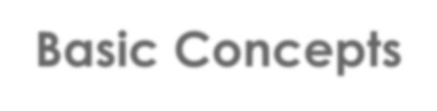

Basic Concepts
What is programming?

Slide 13
Basic Concepts
What is programming?
Programming refers to the process of engineering a piece of software.
For the purpose of this module, this means there is a process leading from a given problem to the construction of a computer program that solves that problem.
Aspects:
 Analysis and understanding of the problem
 Requirements engineering and problem-solving
 Algorithm design and verification
 Implementation in a programming language

Slide 14

Basic Concepts
What is an algorithm?

Slide 15
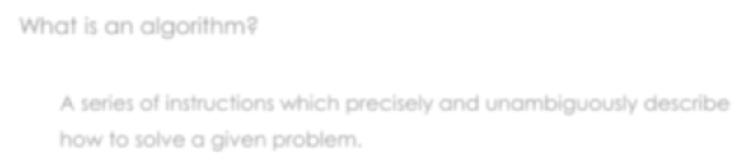
Basic Concepts
What is an algorithm?
A series of instructions which precisely and unambiguously describe
how to solve a given problem.

Slide 16
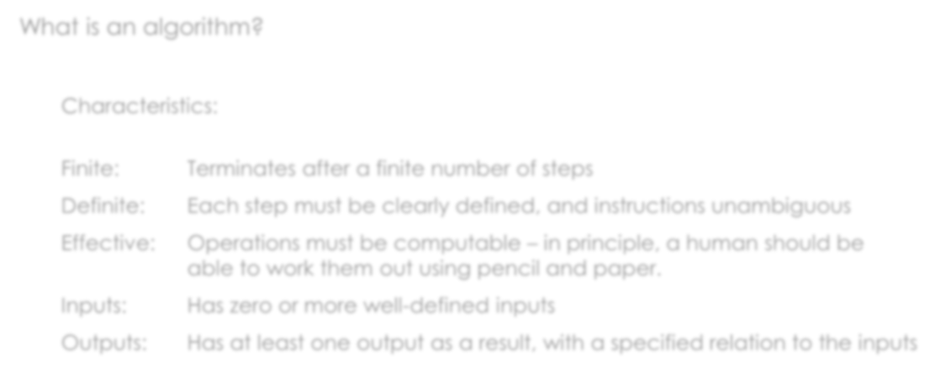
Basic Concepts
What is an algorithm?
Characteristics:
Finite: Definite: Effective:
Terminates after a finite number of steps
Each step must be clearly defined, and instructions unambiguous
Operations must be computable – in principle, a human should be able to work them out using pencil and paper.
Has zero or more well-defined inputs
Has at least one output as a result, with a specified relation to the inputs
Inputs:
Outputs:

Slide 17
Basic Concepts
procedure getACupOfCoffee() {
IF (charge_paid) {
Retrieve a new cup;
Dispense instant coffee portion;
IF (water_temperature is less than 85 deg C) {
3a. Turn on boiler;
3b. Wait for 5 seconds;}
If (water_temperature is greater than or equal to 85 deg C) {
4a. IF (boiler.isOn) then turn off boiler;
4b. Turn on water pump;
4c. Dispense 200ml of hot water;
4d. Turn off water pump;
}
Else{
wait for another 2 seconds;
go back to 4.;
}
5. Return cup;
}
ELSE do nothing;
}

Slide 18
Basic Concepts
What activities are involved in coding?

Slide 19
Basic Concepts
What activities are involved in coding?
 Informally, coding is often used as a synonym to programming, but it actually means
to implement an algorithm in a programming language.
This involves:
 Writing the instructions of the algorithm in the target language (the source code)
 Testing, debugging, and maintaining the source code

Slide 20
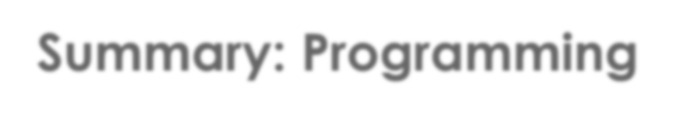
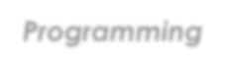
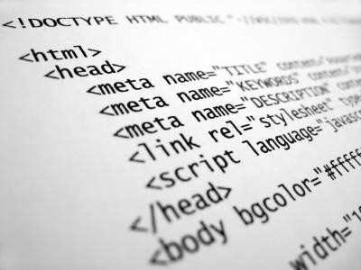
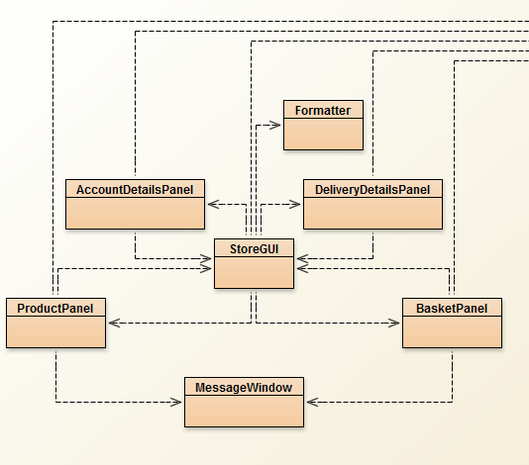

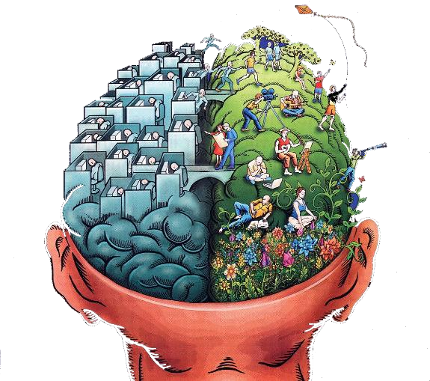
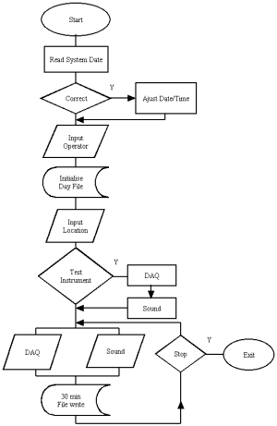

Summary: Programming
Programming
Code
Model
Problem ? ? ? ?
Testing
?
Testing
Analysis Understanding
Algorithm
Testing
Requirements

Slide 21

Programming languages
Which programming languages are we going to deal with in this module?
The programming language we will be focusing on in this module is called C, which is a general-purpose programming language that is highly relevant for engineering & robotics and also quite easy to learn.
Later in the module, we will briefly look at a more advanced programming
framework called object-orientation and the language C++, which builds upon C. And then we will try to do some coding based on embedded computer system, which is widely used in engineering &robotics.
Right at the end of the term, we will look at the lower levels of how digital computers work and get to know how machine code operates.

Slide 22
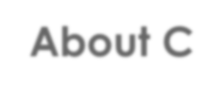
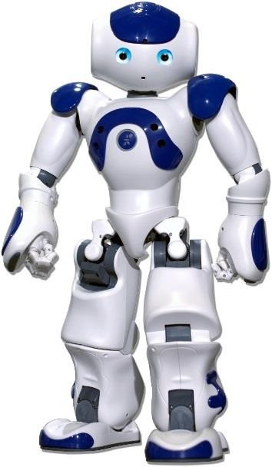
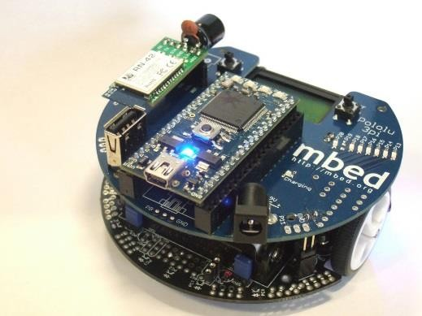
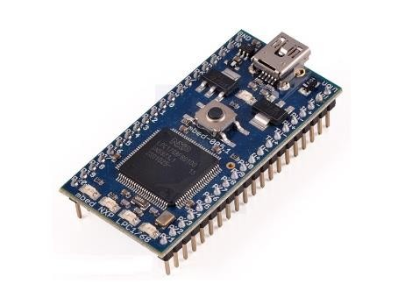
About C
What is C?
 C is a higher-level, general-purpose programming language
 C is imperative
 C is procedural
 C has instructions that humans can read and arrange (human-readable code) which can then be turned into those that machines can carry out (machine code)
 Variants of C are used to program microcontrollers and embedded systems

Slide 23

Hello World!
It’s time to write our first program!
 Open the Quickstart introduction to DevC++
 Run DevC++
 Create a helloworld program

Slide 24
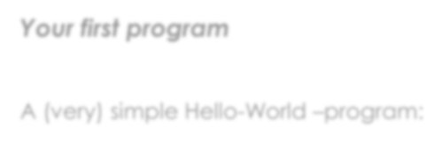
Hello World!
Your first program
A (very) simple Hello-World –program:
#include <stdio.h>
Loads standard functionality for us to be able to
print text onto the screen.
The block of code following “main()” will be
executed automatically when the run the program.
Prints the text specified in the brackets onto the standard output device (screen).
Waits for a key press (we use this as a workaround to keep the program window open so that we can inspect the results. Otherwise, the window would close instantaneously).
main()
{
printf("Hello World!");
getchar();
}

Slide 25

Basic Concepts
How do computers run software programs?

Slide 26
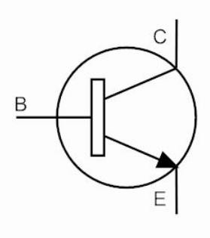
Basic Concepts
How do computers run software programs?
 Today’s digital electronic computers contain a huge number of logic circuits
that are made up from many many transistors.
 These transistors are basically switches, which are operated by electricity.
 The voltage of a control signal (high or low) will determine whether a transistor will let a current pass through or not

Slide 27
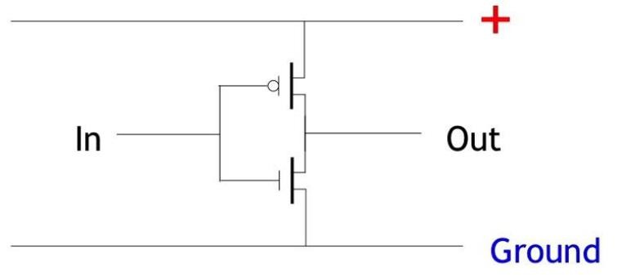
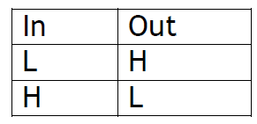
Basic Concepts
How do computers run software programs?
 Multiple transistors of different type can be arranged in particular
ways to implement logic gates (e.g., NOT, AND, OR, XOR, etc.)
Truth table:
Notes:
To so some degree,if the computer want to do calculate or control operation, it should depends such composed logical circuit.
门电路互相组合，形成组合逻辑； 触发器互相组合，形成时序逻辑。 组合逻辑和时序逻辑互相组合，实现数字逻辑。
CPU使用指令集定义计算和控制行为，内部通过译码器完成对二进制数据的"翻译"，改变功能电路的状态。不同的计算和控制行为，都有具体的数字逻辑描述和实现。

Slide 28
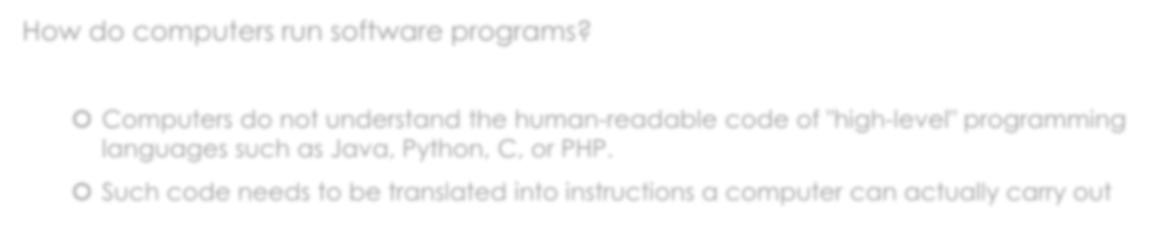
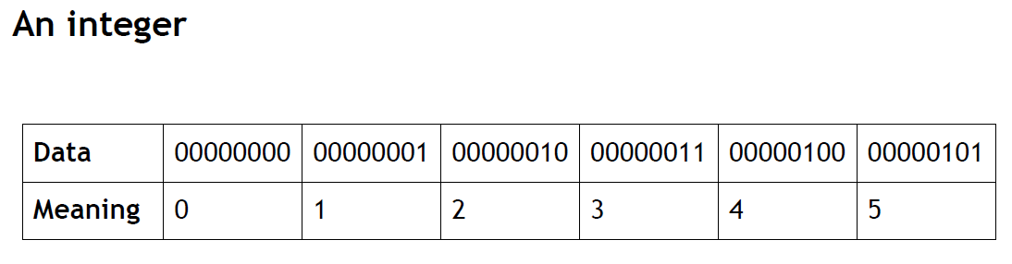
Basic Concepts
How do computers run software programs?
 Computers do not understand the human-readable code of "high-level" programming
languages such as Java, Python, C, or PHP.
 Such code needs to be translated into instructions a computer can actually carry out

Slide 29
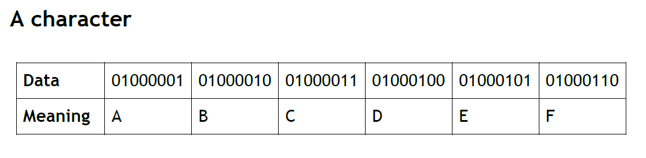
Basic Concepts
How do computers run software programs?
 Computers do not understand the human-readable code of "high-level" programming
languages such as Java, Python, C, or PHP.
 Such code needs to be translated into instructions a computer can actually carry out

Slide 30
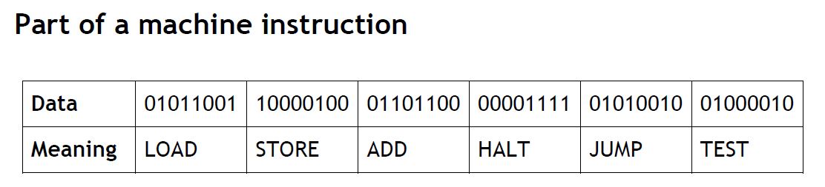
Basic Concepts
How do computers run software programs?
 Computers do not understand the human-readable code of "high-level" programming
languages such as Java, Python, C, or PHP.
 Such code needs to be translated into instructions a computer can actually carry out

Slide 31
Basic Concepts
How do computers run software programs?
 Compile high-level code = Translation before execution
Languages: C, C++, Objective-C
 Interpret high-level code = Translation during execution Languages: JavaScript, PHP, MATLAB
 Compile and interpret = Translation into an intermediate format (e.g., Java bytecode) which is then executed within another software environment (e.g., a virtual machine) Languages: Java, C#, Python

Slide 32
Basic Concepts
Programs require resources to run.
 What are these resources, exactly?

Slide 33
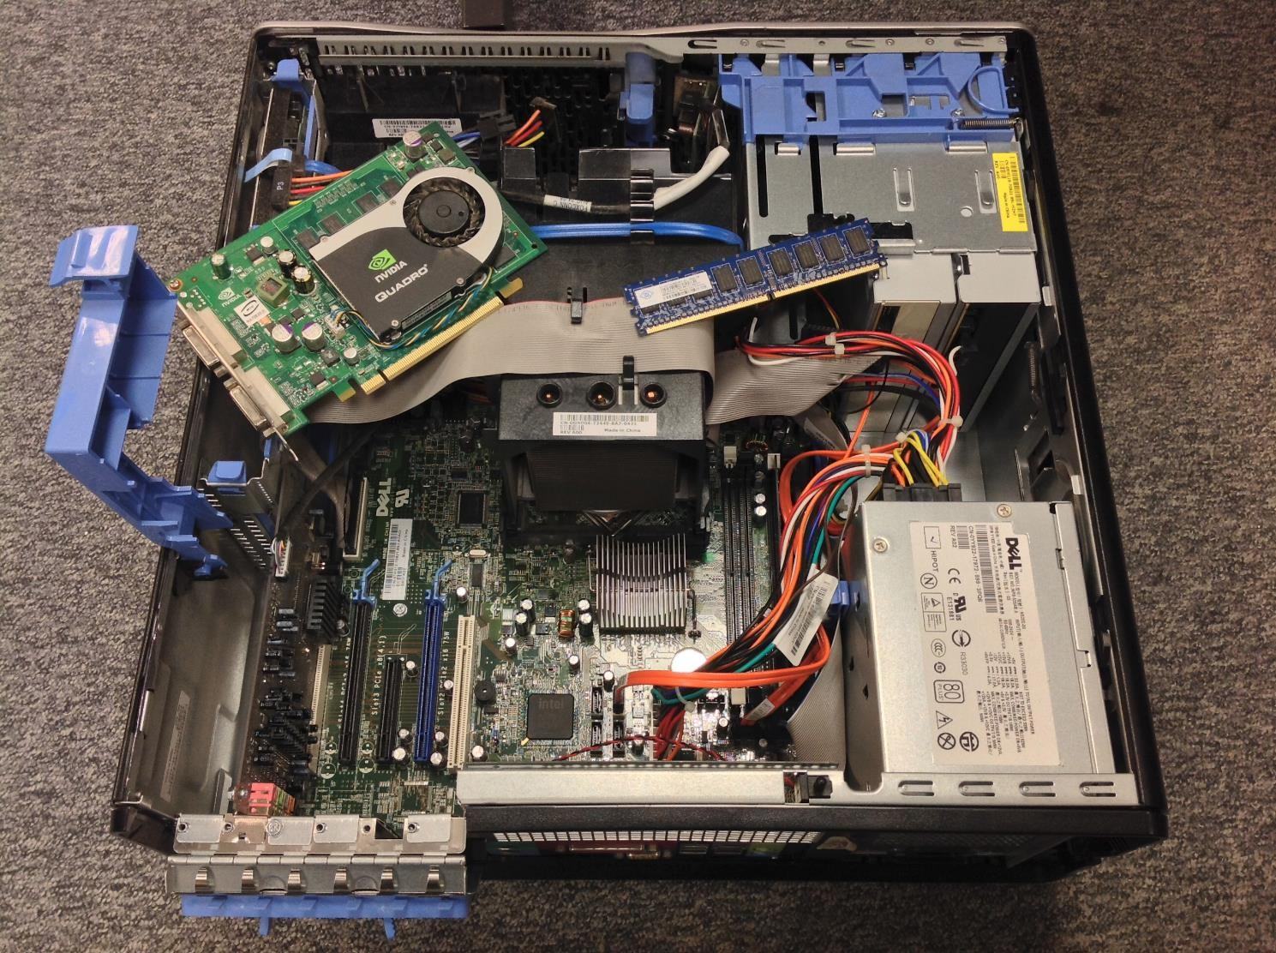
Basic Concepts
Resources
 Physical resources are all devices that are part of or connected to a computer

Slide 34

Basic Concepts
Resources
 Physical resources are all devices that are part of or connected to a computer
Examples:
Central Processing Unit (CPU)

Slide 35
Basic Concepts
Resources
 Physical resources are all devices that are part of or connected to a computer
Examples:
Random Access Memory (RAM)

Slide 36
Basic Concepts
Resources
 Physical resources are all devices that are part of or connected to a computer
Examples:
Hard-Disk Drive (HDD)

Slide 37
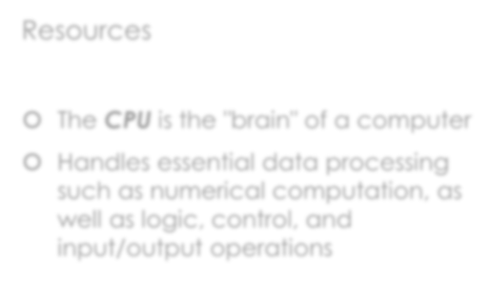
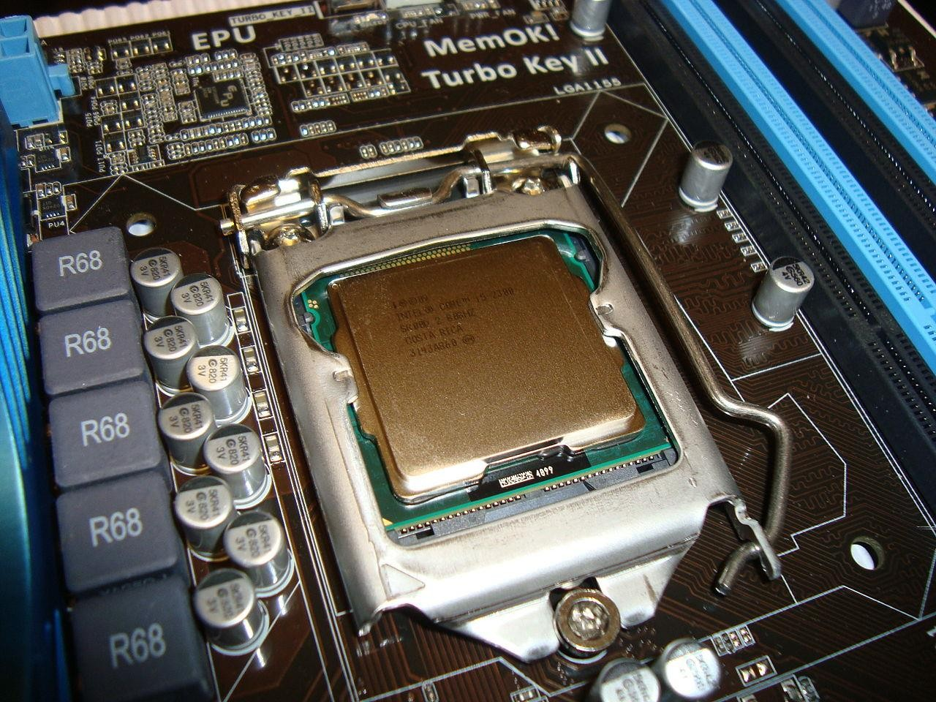
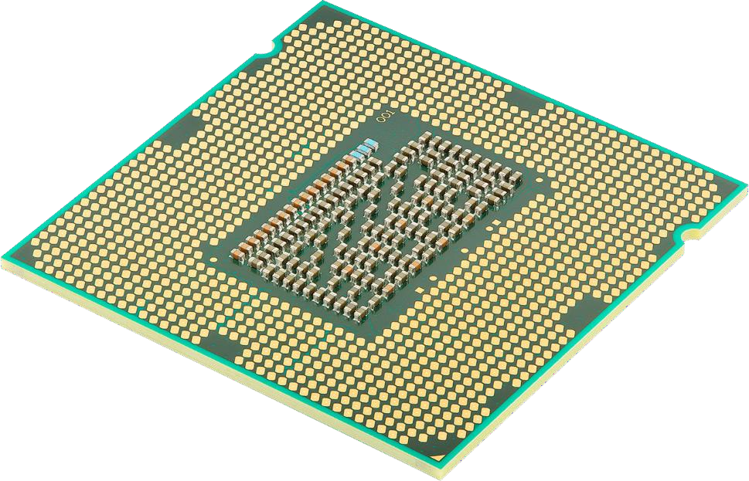
Basic Concepts
Resources
 The CPU is the "brain" of a computer
 Handles essential data processing such as numerical computation, as well as logic, control, and input/output operations

Slide 38
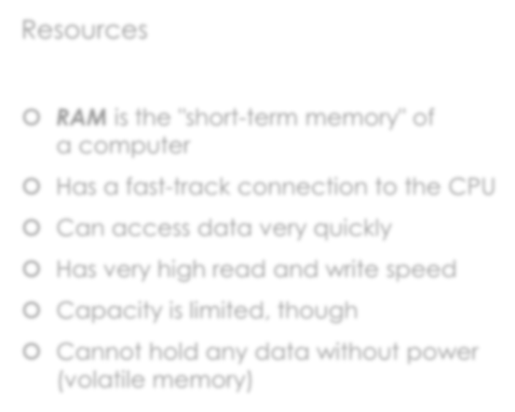
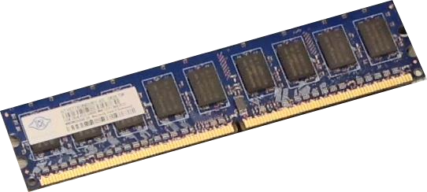
Basic Concepts
Resources
 RAM is the "short-term memory" of
a computer
 Has a fast-track connection to the CPU
 Can access data very quickly
 Has very high read and write speed
 Capacity is limited, though
 Cannot hold any data without power
(volatile memory)

Slide 39
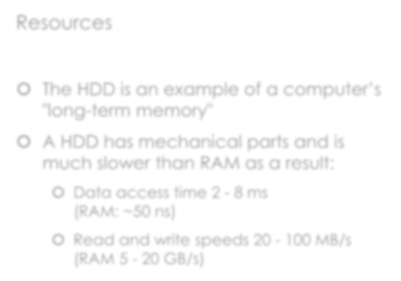
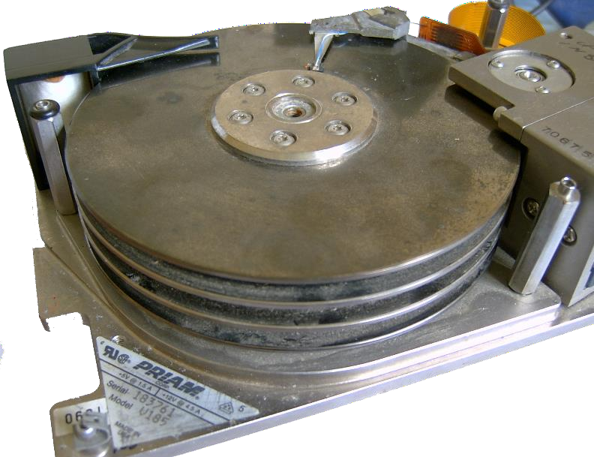
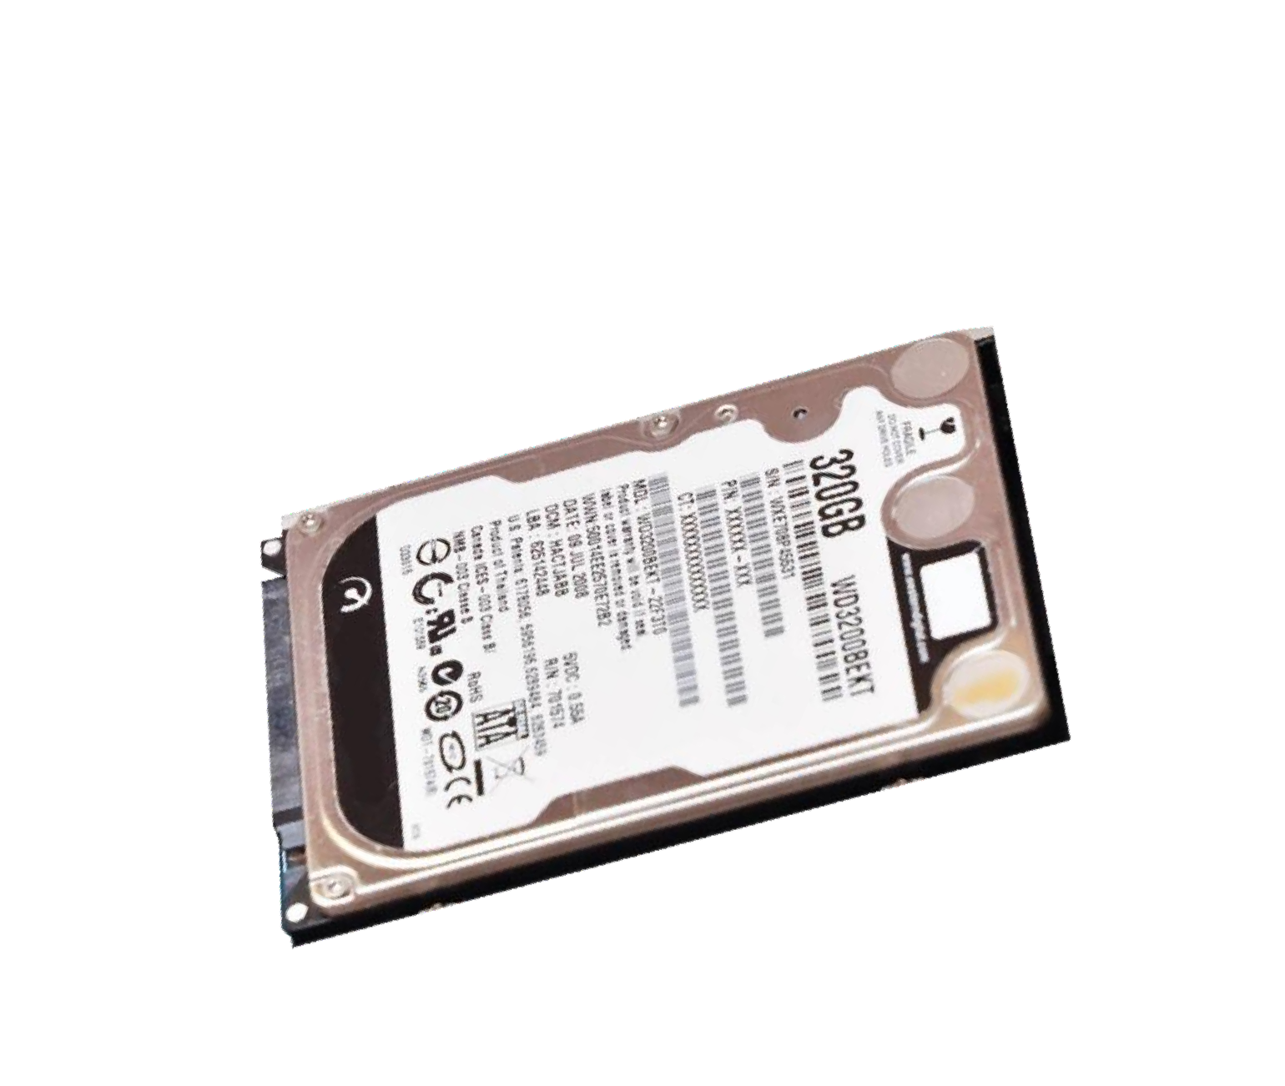
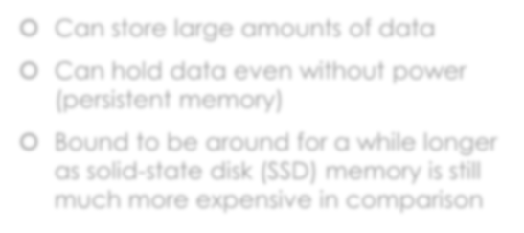
Basic Concepts
Resources
 The HDD is an example of a computer’s
"long-term memory"
 A HDD has mechanical parts and is much slower than RAM as a result:
 Data access time 2 - 8 ms
(RAM: ~50 ns)
 Read and write speeds 20 - 100 MB/s (RAM 5 - 20 GB/s)
 Can store large amounts of data
 Can hold data even without power
(persistent memory)
 Bound to be around for a while longer as solid-state disk (SSD 150-300MB /s) memory is still much more expensive in comparison

Slide 40
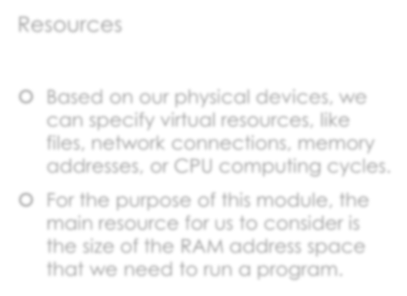
Basic Concepts
Resources
 Based on our physical devices, we can specify virtual resources, like files, network connections, memory addresses, or CPU computing cycles.
 For the purpose of this module, the main resource for us to consider is the size of the RAM address space that we need to run a program.

Slide 41
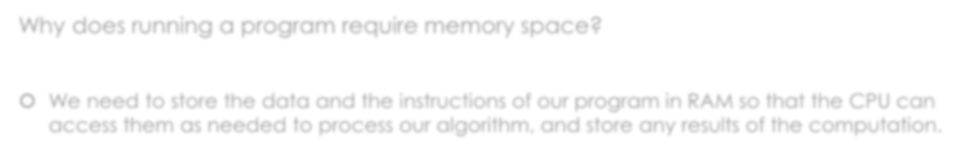
Basic Concepts
Why does running a program require memory space?
 We need to store the data and the instructions of our program in RAM so that the CPU can
access them as needed to process our algorithm, and store any results of the computation.
RAM
Program Instructions
Program Data
Operating System and other programs Free
CPU
Inputs
Arithmetic Unit
 |  |  | Control Unit
Outputs

Slide 42
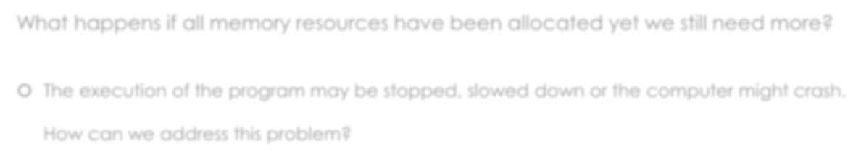
Basic Concepts
What happens if all memory resources have been allocated yet we still need more?
 The execution of the program may be stopped, slowed down or the computer might crash.
How can we address this problem?

Slide 43
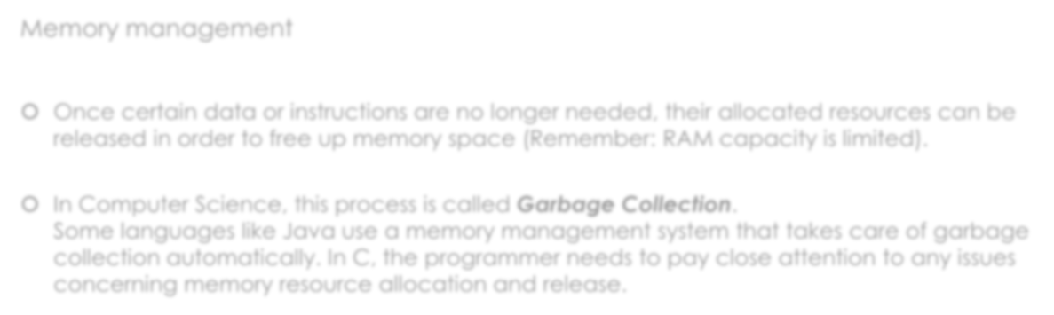
Basic Concepts
Memory management
 Once certain data or instructions are no longer needed, their allocated resources can be
released in order to free up memory space (Remember: RAM capacity is limited).
 In Computer Science, this process is called Garbage Collection.
Some languages like Java use a memory management system that takes care of garbage collection automatically. In C, the programmer needs to pay close attention to any issues concerning memory resource allocation and release. In C++,from C++11 on,smart pointer like share_ptr,unique_ptr,weak_ptr are used.

Slide 44
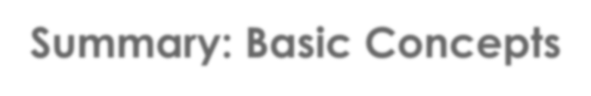
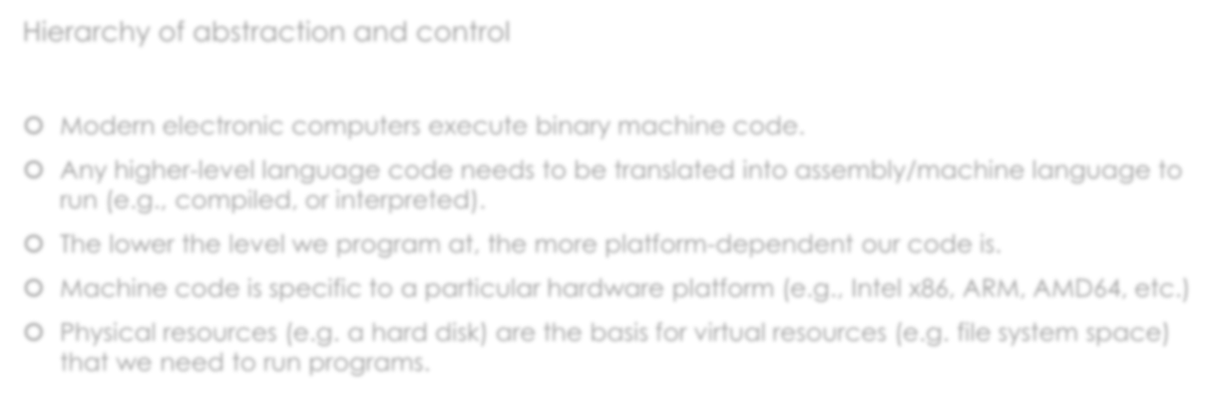
Summary: Basic Concepts
Hierarchy of abstraction and control
 Modern electronic computers execute binary machine code.
 Any higher-level language code needs to be translated into assembly/machine language to run (e.g., compiled, or interpreted).
 The lower the level we program at, the more platform-dependent our code is.
 Machine code is specific to a particular hardware platform (e.g., Intel x86, ARM, AMD64, etc.)
 Physical resources (e.g. a hard disk) are the basis for virtual resources (e.g. file system space) that we need to run programs.

Slide 45

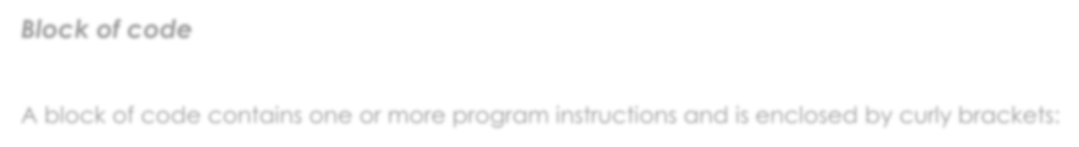
Basic Coding Conventions
Block of code
A block of code contains one or more program instructions and is enclosed by curly brackets:
{
program instruction; program instruction; program instruction;
}

Slide 46
Basic Coding Conventions
Block of code
A block of code contains one or more program instructions and is enclosed by curly brackets:
{
program instruction; program instruction; program instruction;
}
Open brackets need to be "closed" when a block ends.

Slide 47
Basic Coding Conventions
Block of code
A block of code contains one or more program instructions and is enclosed by curly brackets:
{
program instruction; program instruction; program instruction;
}
Instructions within a block of code are usually indented.

Slide 48

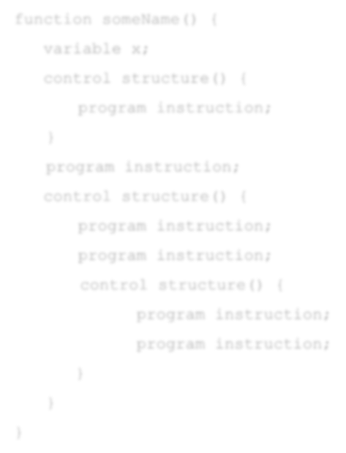

Basic Coding Conventions
function someName() {
variable x;
control structure(){
program instruction;
}
program instruction;
control structure() {
program instruction;
program instruction;
control structure() {
program instruction;
program instruction;
}
}
}
Properly indented code is easier to read.

Slide 49
Basic Coding Conventions
Block of code
A block of code contains one or more program instructions and is enclosed by curly brackets:
{
program instruction; program instruction; program instruction;
}
The semicolon marks where an instruction ends.

Slide 50
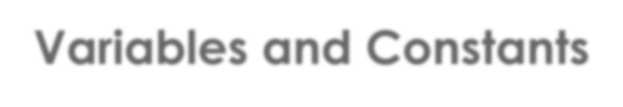
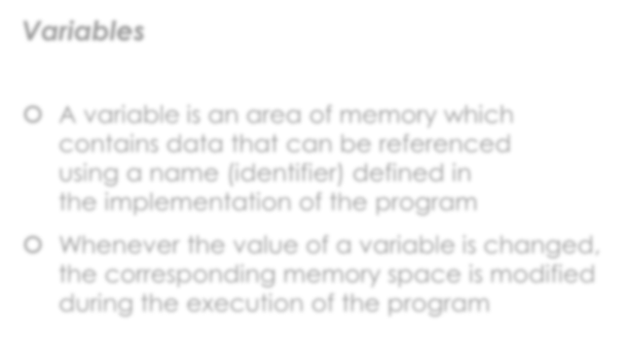
Variables and Constants
Variables
 A variable is an area of memory which contains data that can be referenced using a name (identifier) defined in the implementation of the program
 Whenever the value of a variable is changed, the corresponding memory space is modified during the execution of the program
Type
identifier
int number;
Declaration of variable

Slide 51
Variables and Constants
Variables: Storing data
Assignment Operator
Expression
 Values are stored into variables via assignment statements
 An assignment statement consists of the
assignment operator (=) and an expression
 An expression can be a number or a combination of numbers, variables, and other operators
number = 20;
 The data types of a variable and its value must match Assigning a value to a variable
 If another value is assigned to the same variable, the previous value is lost!

Slide 52

Variables and Constants
Variables in memory
RAM
int number;
reserves space
number

Slide 53

Variables and Constants
Variables in memory
RAM
reserves space
int number;
number
Usually a 32bit signed (max. 2147483647)
or unsigned integer(max. 4294967295)

Slide 54
Variables and Constants
Variables in memory
RAM
int number;
number = 20;
20

Slide 55
Variables and Constants
Variables in memory
RAM
int number;
number = 20;
number = 20 + 5;
25

Slide 56
Variables and Constants
Variables in memory
RAM
int number;
number = 20;
number = 20 + 5; number = number + 8;
33

Slide 57

Variables and Constants
Variables in memory
RAM
int number;
33
number = 20;
number = 20 + 5; number = number + 8;
Retrieves current value
Evaluates expression
Overwrites current value with new value

Slide 58
Variables and Constants
Simple datatypes overview
 int
an integer. Usually 4 bytes/32bits
 float
a floating point number. 6-7 digits precision. Usually 4 bytes/32bits
double
a floating point number. 15-16 digits precision. Usually8 bytes/64bits
char
a single character. Like, ‘a’
 void
special datatype, has no value

Slide 59
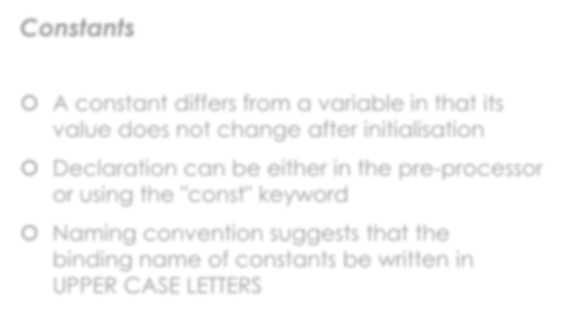
Variables and Constants
Constants
 A constant differs from a variable in that its
value does not change after initialisation
 Declaration can be either in the pre-processor or using the "const" keyword
 Naming convention suggests that the binding name of constants be written in UPPER CASE LETTERS
Declaration of a constant using #define
Constant name
Keyword Value
#define LEGAL_DRINKING_AGE 18;
Assignment operator
Keyword
Type
Constant name
Value
const int LEGAL_DRINKING_AGE = 18;
Declaration of a constant using const

Slide 60
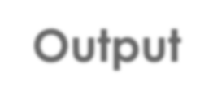
Output
printf ( %[flags][width][.precision][length] , variables )
 e.g.:
char c; c = 'A';
printf("Character: %c\n\nASCII code: %d", c , c);
float f;
f = 3.141592;
printf("Number: %.2f", f);

Slide 61

Input
scanf ([=%[*][width][modifiers]type=] , variables )
 e.g.:
int i;
printf("Enter a number:"); scanf("%d", &i); printf("You entered %d", i);

Slide 62
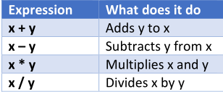
Practice time
Use what you’ve learned to experiment inputting two data from keyboard and do arithmetic operations listed in the following sheet, then print out the results.

Slide 63

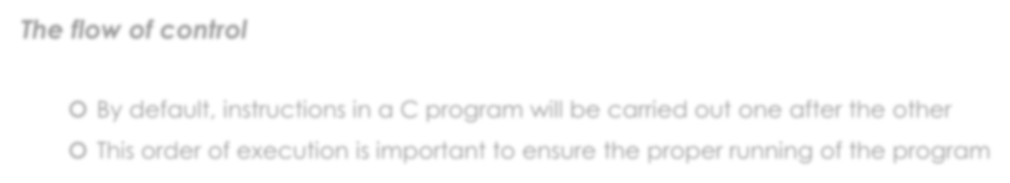
Making choices
The flow of control
 By default, instructions in a C program will be carried out one after the other
 This order of execution is important to ensure the proper running of the program
start
#include <stdio.h>
If we wanted to implement an element of choice, i.e. code that represents alternative paths of execution,
how could we do this?
main() {
int i; i = 20; i++;
printf("%d", i);
getchar();
return 0; finish
}

Slide 64
Making choices
The flow of control
 We need to create alternative blocks of code and then determine by evaluating an
expression which of these blocks will be entered for execution.
In pseudo code: In C code:
Is this expression true?
if (some expression is true) then do the following
instructions here…
otherwise, do something else
other instructions here…
if (i == 20) {
true
printf("You entered 20");
}
else {
false
}
printf("You entered something else");

Slide 65
Making choices
The flow of control
 We need to create alternative blocks of code and then determine by evaluating an
expression which of these blocks will be entered for execution.
"equals" operator
In pseudo code: In C code:
if (some expression is true) then do the following
instructions here…
otherwise, do something else
other instructions here…
if (i == 20) {
printf("You entered 20");
}
else {
printf("You entered something else");
}

Slide 66

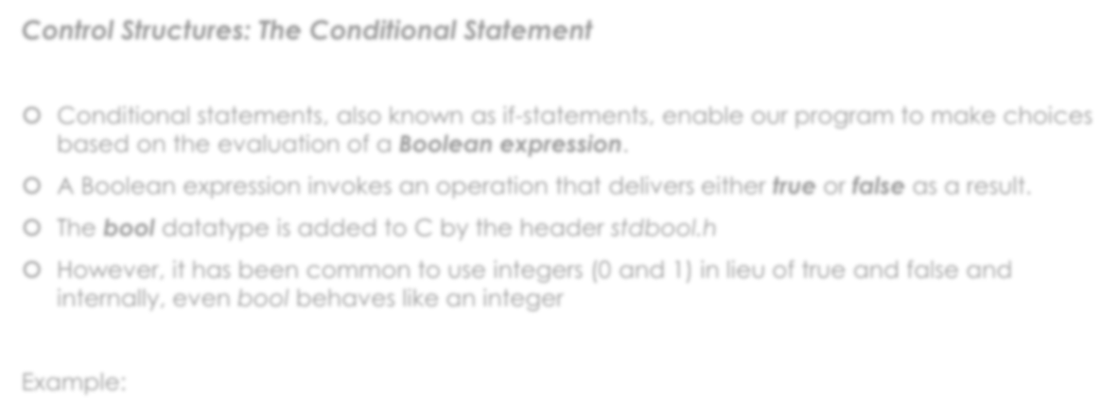
Making Choices
Control Structures: The Conditional Statement
 Conditional statements, also known as if-statements, enable our program to make choices
based on the evaluation of a Boolean expression.
 A Boolean expression invokes an operation that delivers either true or false as a result.
 The bool datatype is added to C by the header stdbool.h
 However, it has been common to use integers (0 and 1) in lieu of true and false and
internally, even bool behaves like an integer
Example:
int money = 20;
bool b = (money > 20);
"greater than" operator

Slide 67

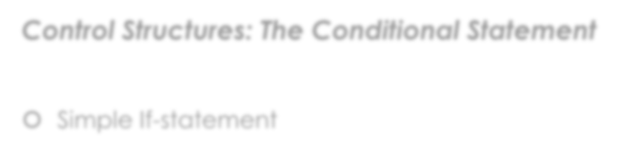
Preview: Making Choices
Control Structures: The Conditional Statement
 Simple If-statement
if(Boolean expression that returns true or false)
{
instructions that will be executed
if Boolean expression returns true;
}

Slide 68
Preview: Making Choices
Control Structures: The Conditional Statement
 Simple If-statement
"less than" operator
if(money < 12)
{
printf("Insufficient funds");
}

Slide 69
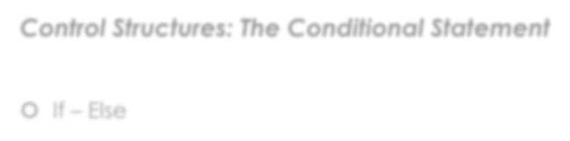
Preview: Making Choices
Control Structures: The Conditional Statement
 If – Else
if(Boolean expression that returns true or false)
{
instructions that will be executed
if Boolean expression returns true;
}
else
{
instructions that will be executed
if Boolean expression did not return true;
}

Slide 70
Preview: Making Choices
Control Structures: The Conditional Statement
 If – Else
if(money < 12)
{
printf("Insufficient funds");
}
else
{
printf("Thank you!");
}

Slide 71
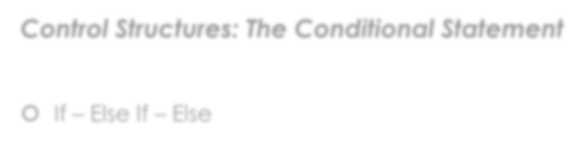
Preview: Making Choices
Control Structures: The Conditional Statement
 If – Else If – Else
if(Boolean expression that returns true or false) { instructions that will be executed
if Boolean expression returns true;
}
else if(Another Boolean expression that returns true or false) { instructions that will be executed
if the first Boolean expression did not return true;
}
else {
instructions that will be executed
if neither of the above Boolean expressions returned true;
}

Slide 72
Preview: Making Choices
Control Structures: The Conditional Statement
 If – Else If – Else
if(money < 12)
{
printf("Insufficient funds");
}
else if(money > 12)
{
printf("That is very generous of you!");
}
else
{
printf("Thank you!");
}

Slide 73
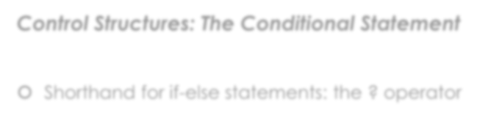
Preview: Making Choices
Control Structures: The Conditional Statement
 Short hand for if-else statements: the ? operator
(Boolean expression) ? instruction to run if true : instruction to run if false;

Slide 74

Preview: Making Choices
Control Structures: The Conditional Statement
 Shorthand: the ? operator
(money < 12) ? printf("Insufficient funds") : printf("Thank you!");

Slide 75

Preview: Making Choices
Control Structures: The Conditional Statement
 Switch
switch (any case case case | expression) { constant result1: constant result2: constant result3: | instruction instruction instruction | to to to | run; run; run;
.
.
.
default: instruction to run if none of the above fire;
}

Slide 76

Preview: Making Choices
Control Structures: The Conditional Statement
 Switch
switch (money) {
case 0 : printf("No money given!");
case 12: printf("Thank you!");
default: printf("That’s not the right amount!");
}
 What happens here?

Slide 77

Preview: Making Choices
Control Structures: The Conditional Statement
 Switch
switch (money) {
case 0 : printf("No money given!");
break;
case 12: printf("Thank you!");
break;
default: printf("That’s not the right amount!");
}
 We need to break the flow of execution after one of the expressions fires!

Slide 78


Preview: Useful Operators in C
Relational operators
 two operands x and y are directly compared
Expression | What does it do?
x == y | Checks if x and y are equal and returns true if they are
x > y | Checks if x is greater than y and returns true if it is
x < y | Checks if x is less than y and returns true if it is
x >= y | Checks if x is greater than or equal to y and returns true if it is
x <= y | Checks if x is less than or equal to y and returns true if it is
x != y | Checks if x and y are equal and returns true if they are not

Slide 79

Preview: Useful Operators in C
Logical operators
Expression | How many operands? | What does it do?
!x | One | Performs logical NOT (negates current truth value)
x && y | Two or more | Performs logical AND (true if both true)
x || y | Two or more | Performs logical OR (true if at least one true)
Truth tables
AND
OR
NOT
x | y | result
0 | 0 | 0
0 | 1 | 0
1 | 0 | 0
1 | 1 | 1
x | y | result
0 | 0 | 0
0 | 1 | 1
1 | 0 | 1
1 | 1 | 1
x | result
0 | 1
1 | 0

Slide 80


Next Lecture
 Conditional statements and control structures

Slide 81


Read
 Kernighan and Ritchie
 Chapter 1.1-1.5
 Sections 2.1 – 2.12
 Sections 3.1 – 3.4

